Slide 1

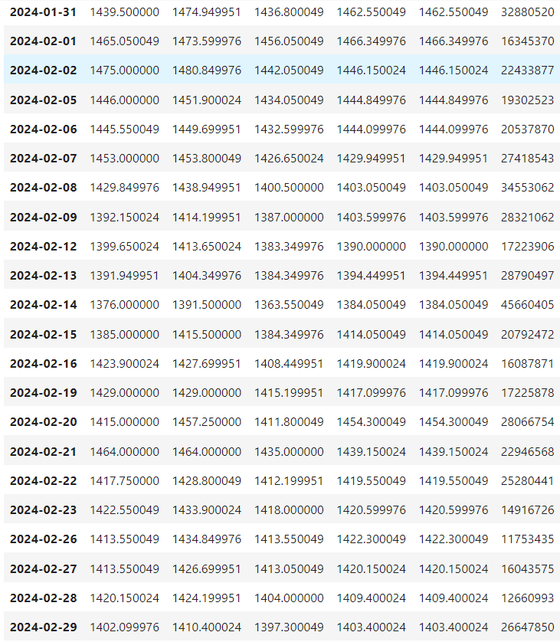
STOCK MARKET PREDICTION
Company Name – Reliance Industries
Algorithm Used : Linear Regression, Support Vector Machine, KNN, DT, Random Forest, LSTM
Features Used : Open, High, Low, Close
Input Data – 21 Days (3 week) (Only working days included)

Slide 2
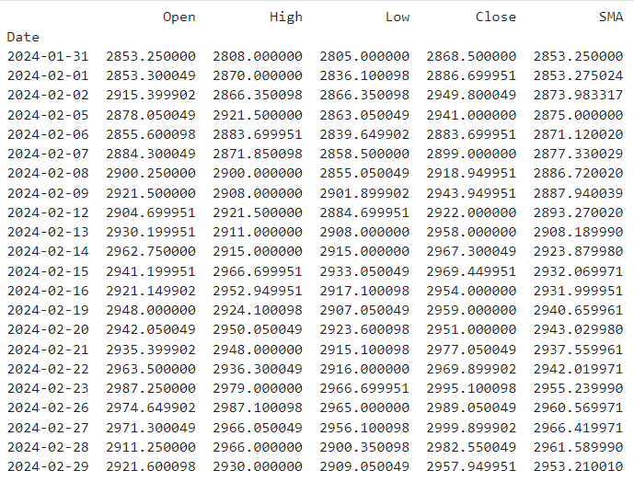
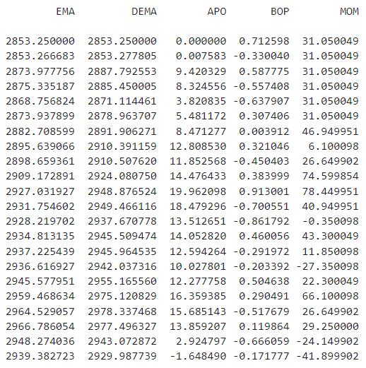
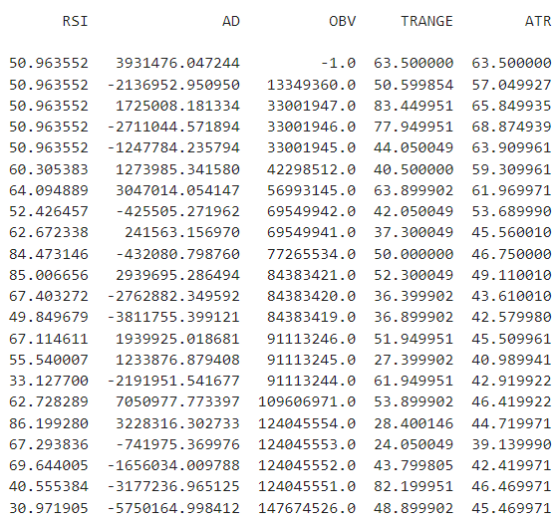


Slide 3
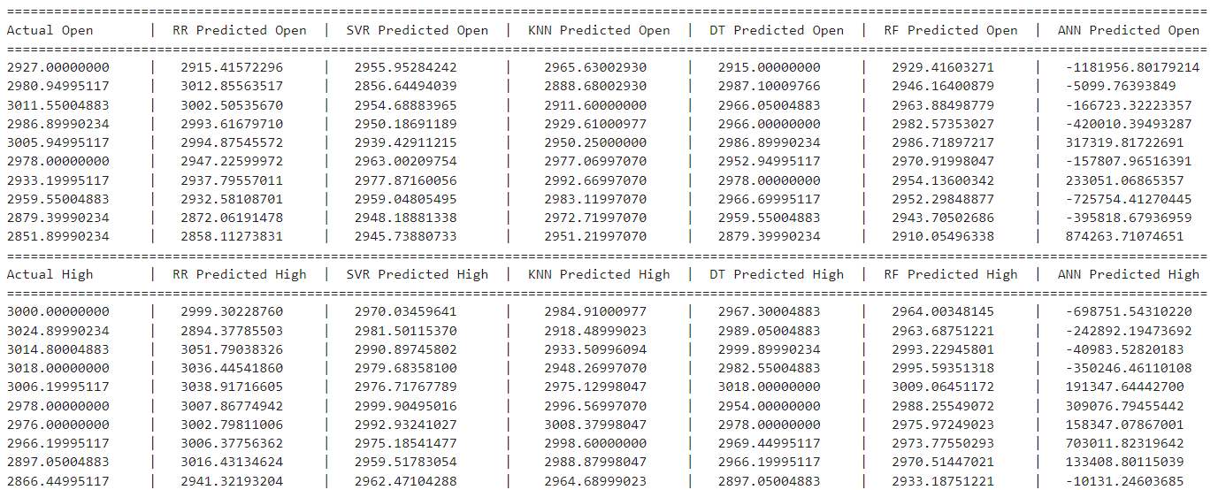
COMPARED ACTUAL AND PREDICTED PRICES
OPEN
HIGH

Slide 4
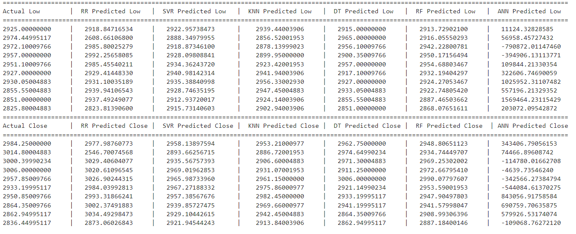
COMPARED ACTUAL AND PREDICTED PRICES
LOW
CLOSE

Slide 5
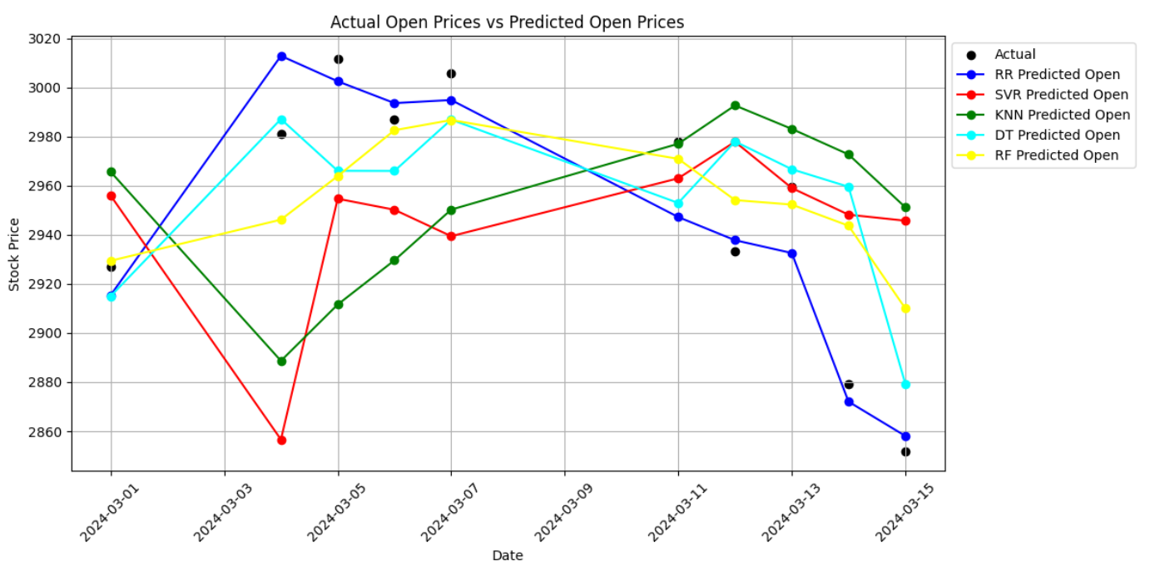
OPEN PRICE

Slide 6
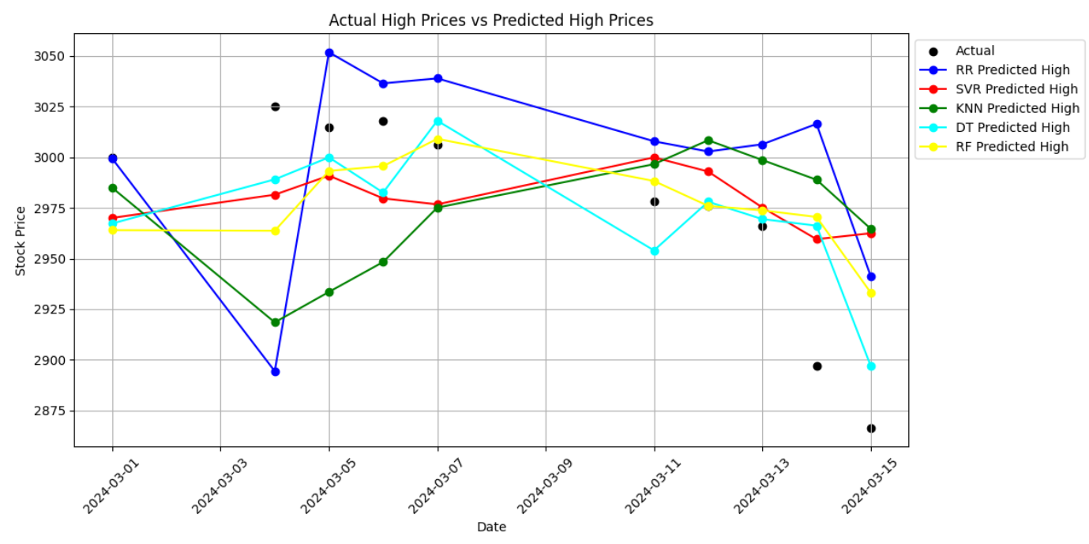
HIGH PRICES

Slide 7
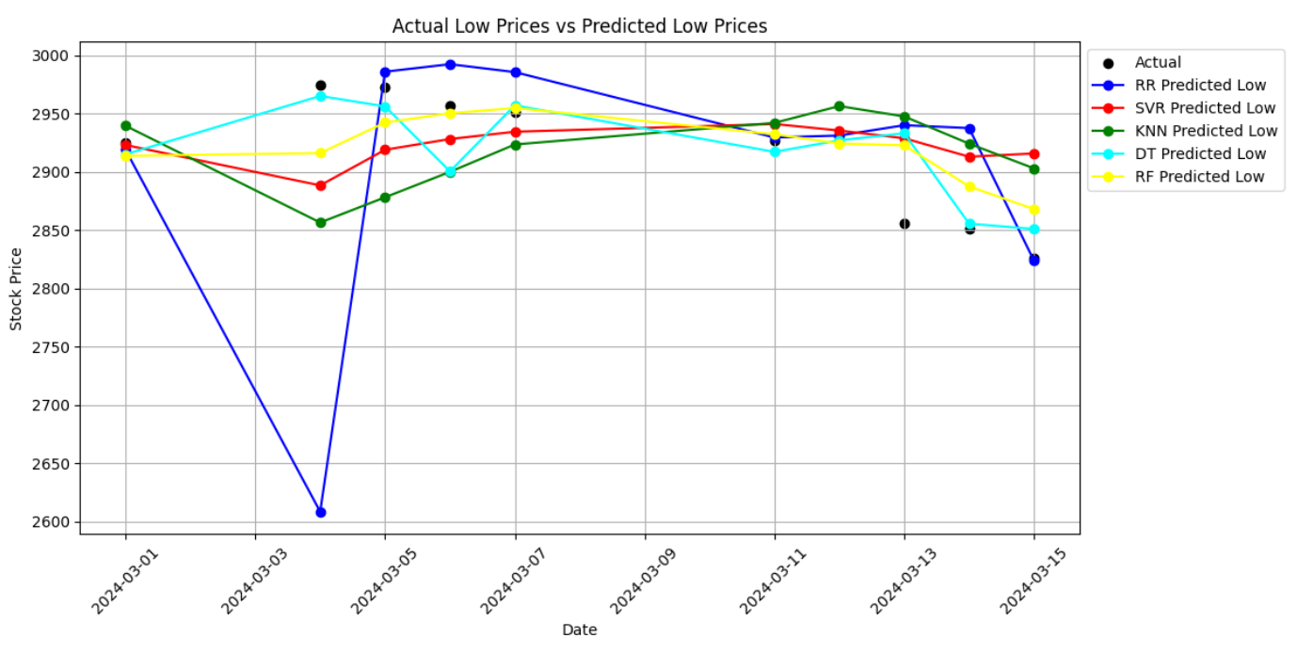
LOW PRICES

Slide 8
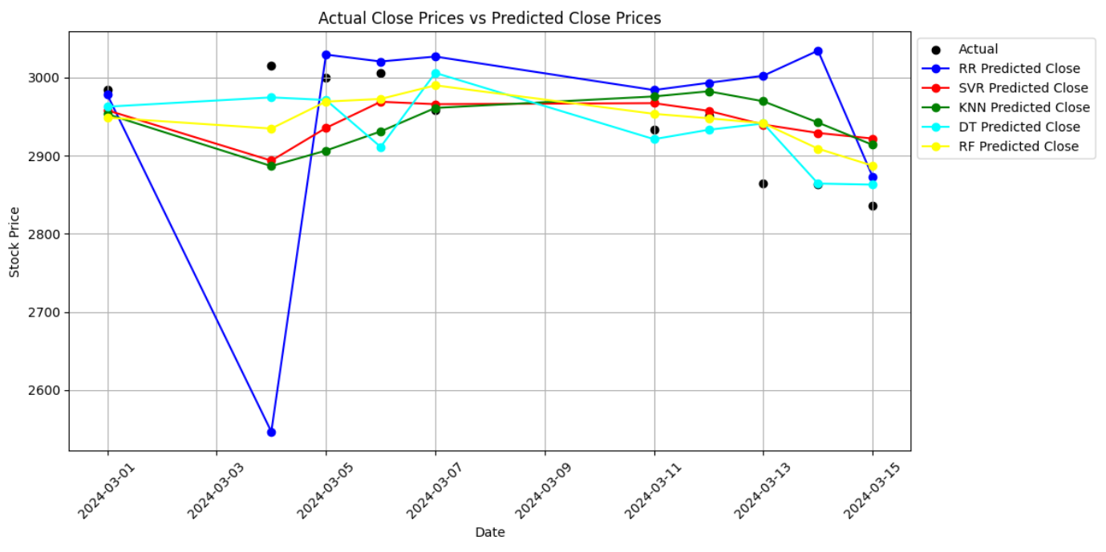
CLOSE PRICES

